Slide 1


Abstra
Lazar Milicevic
Weekly support report
Support, Challenges, Sollutions
17.06.2025

Slide 2
Agenda
1. Zendesk Ticket Management & Optimization
3. Reported & Tracked Issues
5. Next Steps
2. Infra & Product Coordination
4. Visual & Helpdesk Improvements
6. Q&A

Slide 3

Infra & Product Coordination
Customer success: Weekly Support Report – 01.07.2025
Where we are now ?
Manually reviewed and approved 200+ Cognito users (now disabled after project pause)
Investigated and revoked unauthorized access to K-Navigator (Daiichi Sankyo case)
• Clarified onboarding/offboarding logic for Pharma users
• Distributed WireGuard VPN configs and guided new users through the setup
• Validated account creation dates and platform access for selected users
• Held multiple onboarding sessions with external MOSAIC users
• Created 25+ Abstra accounts and provided personalized support
• Resolved login/access issues via live calls (Hackathon users, VPN IP mismatches)
• Shared custom instructions and credential handoffs
• Actively tracked edge cases not present in Zendesk
• Clarified metrics mismatch between Zendesk and Cognito (Ness)

Slide 4
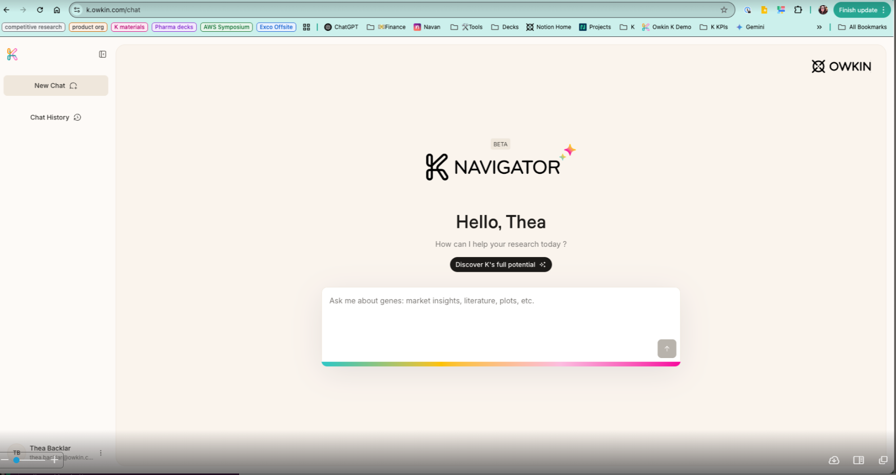
Reported & Tracked Issues
Customer success: Weekly Support Report – 01.07.2025
Some of them:
Closely monitored end-to-end onboarding for Abstra external users:
Manual account creation in Keycloak
Automated Terms of Use email and OTP setup
Manual Zendesk email with instructions for accessing Abstra
Identified users who didn’t complete Abstra login; cross-checked tickets and followed up directly.
Collaborated with Marketing, Product, Infra, and Data teams
• Reassigned misrouted Zendesk ticket and ensured follow-up
• Created HTML Version of K-Navigator Onboarding email, to align with marketing requests.
• Maintained transparency with all team members during fast iterations

Slide 5

Visual & Helpdesk
Customer success: Weekly Support Report – 01.07.2025
✅ Multiple onboarding sessions completed, for external users.
✅ Created multiple new triggers and two new forms, to improve current processes.
Maintained and improved the daily Zendesk signup report script:
Integrated external email mapping
Output includes multi-tab Excel file (raw + summary)
Improved date validation and fallback logic
• Created and deployed new Zendesk form for IT Cloud Requests - Napta project code (validated)
- Azure region selection, TPM quotas
- Dashlane recipient configuration
Working on Proprietary Dataset form with Romain Castellari
Schedualed live working session for complex form changes

Slide 6
Next Steps
Customer success: Weekly Support Report – 17.06.2025
?
📥 Continue daily signup report exports to Google Drive
✅ Finalize access setup for Ewa
👥 Guide Ewa through full onboarding lifecycle
🎯 Monitor widget behavior in FullStory regarding K-Navigator
🔄 Support the transition to automated approval workflow, adjust based on real user behavior

Slide 7

Q&A
Customer success: Weekly Support Report – 03.06.2025
?

Slide 8
Thank you!

